Slide 1
SOFTWARE PROJECT LAB -1
SUBMITTED BY
Hasnain Sheikh
Class Roll :BSSE 1408
SUPERVISED BY :
DR. Emon Kumar Dey
Associate Professor
IIT, University of Dhaka

Slide 2
Language Used : C/ C++ Github Link: Hasnain041501/SPL-1.final (github.com)
Project Name : Basic Image processing tools

Slide 3
What is Image Processing
Image processing is a method to perform some operations on an image, in order to get an enhanced image or to extract some useful information from it.
Goal: Enhance or analyze images for various applications across different fields.

Slide 4
Importance of Image Processing:
Medical Imaging: Enhancing medical scans for diagnosis.
Computer Vision: Enabling machines to interpret visual information
Satellite Imaging: Extracting valuable data from satellite images.
Entertainment: Enhancing and editing images in photography and film
Image processing makes digital images available in any desired format.

Slide 5
PROJECT MOTIVATION
Want to explore the image manipulation side of the technology field
Make images more informative and engaging.
Extract meaningful information from images.
Try to understand bit operation inside pixels
Manipulating an image to extract information or enhance features.
Want to work on a bigger project which will require rigorous work on image manipulation

Slide 6
PROJECT OBJECTIVES
Deliver a fully functional software with interactive user interface
Edit a 24-bit bitmap image
Completion of basic image processing operations
Apply ten image processing algorithms to an image
Successful resolution of a specific image processing challenge
Save an edited image for future purposes

Slide 7
Features
Brightening
Blurring
Image Flip
Image Darkener
Grey Scaling
Smoothing
Negation
Angle Calculation
Sharpening
Histogram
Edge Detection

Slide 8
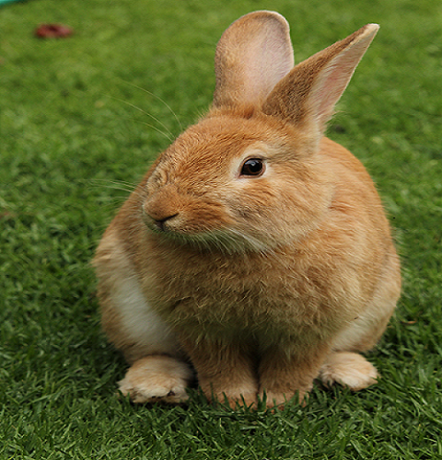
READING AN IMAGE
Reading the image.bmp image as input
Reading header info
Reading pixel data
Storing the data in structure variables

Slide 9
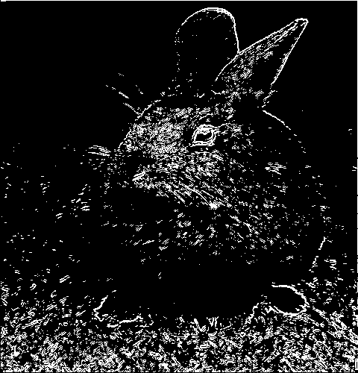
Edge Detection
Convert the Input Image into Grayscale
Use Convolution algorithm
Convolution by Sobel Operator(Gx & Gy)
Calculate resultant intensity for each pixel
Use Threshold to detect edges
Save modified image in a new file

Slide 10
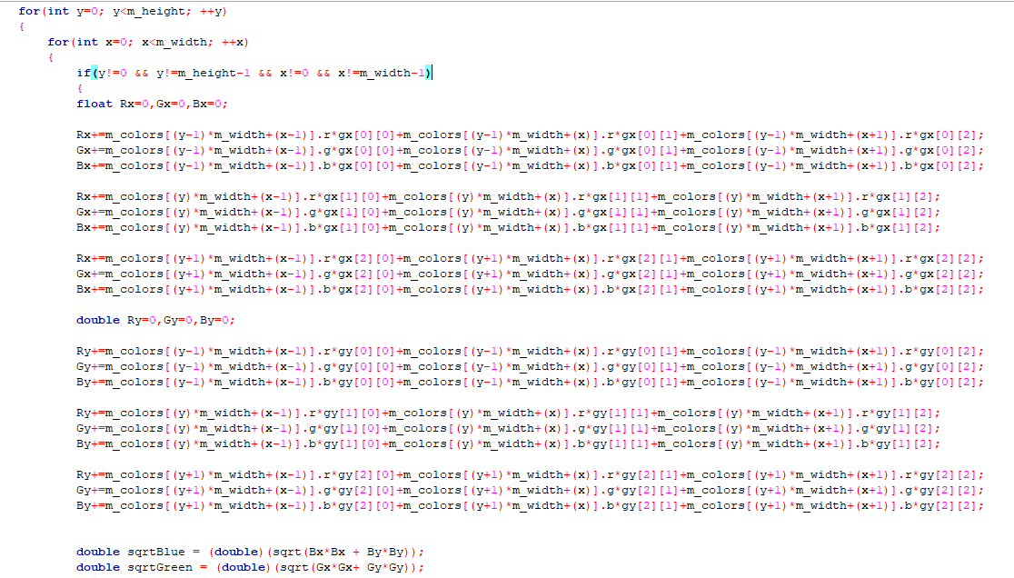
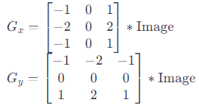
Edge Detection
Convolution Algorithm
Sobel Operator

Slide 11
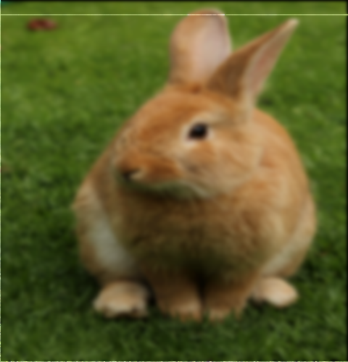
Gaussian Blur
Input a RGB 24-bitmap image
Use Convolution algorithm for Blurring
Use Gaussian filter
Save modified image in a new file

Slide 12
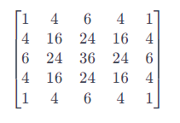
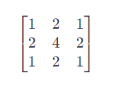
Gaussian Blur
(5 x 5) Gaussian Filter
(3 x 3) Gaussian Filter

Slide 13
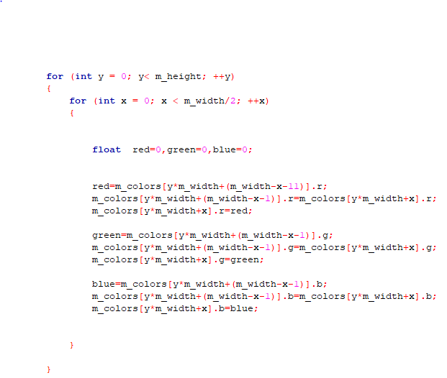
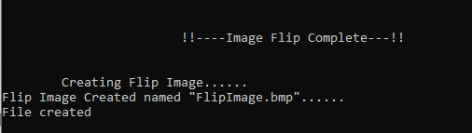
Image Flip
Input a 24-bitmap image
Swap image pixels symmetrically
For Horizontal Flip swap pixel in each row symmetrically
For Vertical Flip swap pixel in each column symmetrically
Save modified image in a new file
Flipping Algorithm

Slide 14
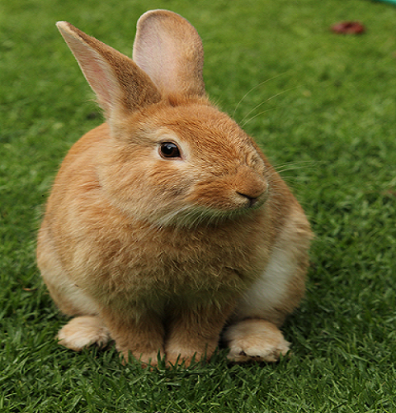
Image Flip
Original Image
Flipped Image

Slide 15
Image sharpening
Input a RGB 24-bitmap image
Use Different types of filters for sharpening
Use Convolution algorithm
Check Boundary limit ( 0-255)
Save modified image in a new file

Slide 16
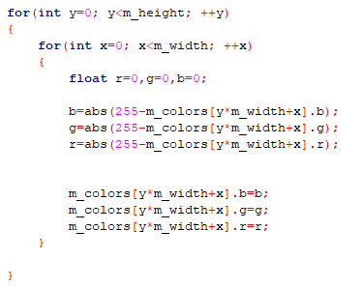
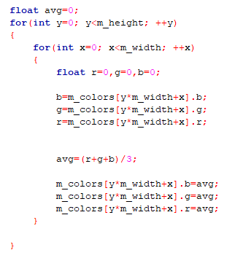
Negation
Grayscale

Slide 17
WRITING THE PROCESSED IMAGE
Opening a new file in writing mode
Writing header info
Writing the modified pixel data
Closing the file

Slide 18
STUDIES FOR THE PROJECT
Reading and Writing a file properly
Manipulating an image at a pixel level.
Different parts of a digital image
Algorithm for image processing

Slide 19
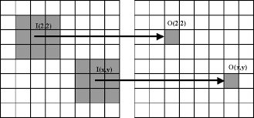
MEDIAN FILTER

Slide 20
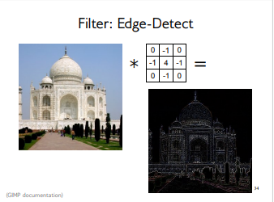
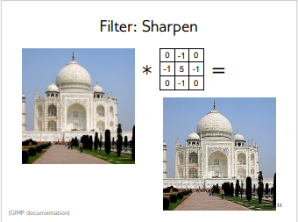
Discrete 2D Convolution:

Slide 21
FUTURE SCOPES
Every tool is implemented as a function, these functions can be used as a part of other image processing projects
More tools can be added to the software
Software can be used as a part of a bigger image processing project

Slide 22
Thank You

